Slide 1

Gen-AI app – Virtual Therapist
(an Intelligent assistant that can generate therapeutic messages after analyzing user’s input speech and deciphering their Emotional state).
https://huggingface.co/spaces/netgvarun2005/VirtualTherapist

Slide 2
Features (Functional)
Speech processing and analysis.
Speech transcription in real-time.
7 emotions category classification : Happy, Sad, Angry, Fearful, Disgusted, Surprised and Calm.
Able to decipher emotions with ~80% accuracy.
User can either upload a short audio (wav file) or record an audio snippet!
Low latency (<1.5 minutes) Emotion prediction and English text transcription.
Powerful Gen-AI component that generates one-liner helpful tips based on Emotions as ‘prompt’.
Gen-AI component can generate up to 10 helpful unique tips.
User can toggle between more balanced suggestions vs more creative ones.
User can request to generate suggestions as many times as desired or reset the complete process through one click.

Slide 3
Features (Technical)
Custom architecture combining SOTA models HUBERT and BERT for speech processing and text processing, respectively.
Novel design methodology of jointly training audio embeddings obtained from HUBERT with the text embeddings obtained from BERT models after transcribing raw input audio using OpenAI's WHISPER model.
Unique amalgamation of Speech with Gen-AI frameworks to create a powerful web-based application.
Leverages Finetuned GPT-neo-1.3B parameter LLM model with Emotion labels as prompts.
Data set generated using prompt-engineering of CHAT-GPT.
Data set expanded and augmented by using PEGASUS paraphrasing model.
Lightweight stream lit based front end.
Cloud Deployment using Huggingface for the App and models.

Slide 4
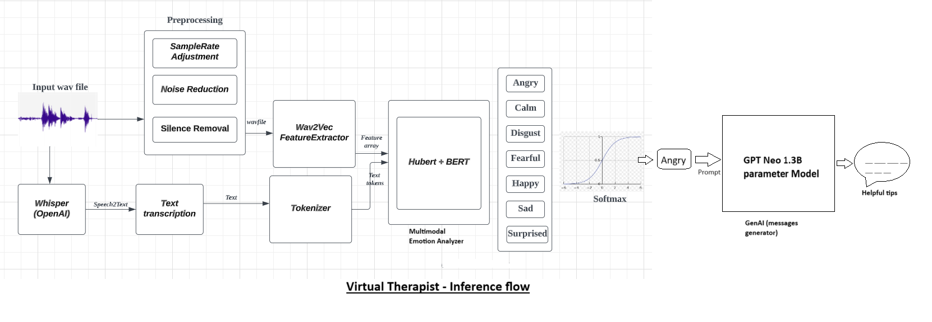
Flow Diagram
User’s speech input is pre-processed, and speech & text features analysed for emotions classification. Based on emotion labels,
Gen-AI component is invoked with labels as prompts to generate suggestions

Slide 5
APPENDIX – DEMOS
Users are presented with a bright colourful interface where they can either upload an audio or record (through an external link – button on left pane).
Using ‘Browse files’ button, uploaded the audio, which is then processed, and transcriptions are generated in left pane.
User can playback the audio by clicking the ‘play’ button
Automatically, the MultiModal model is invoked to generate Emotion class predictions.
Upon clicking the ‘Show Helpful Tips’ button, Gen-AI engine is invoked to generate therapeutic messages based in emotion label prompts.

Slide 6
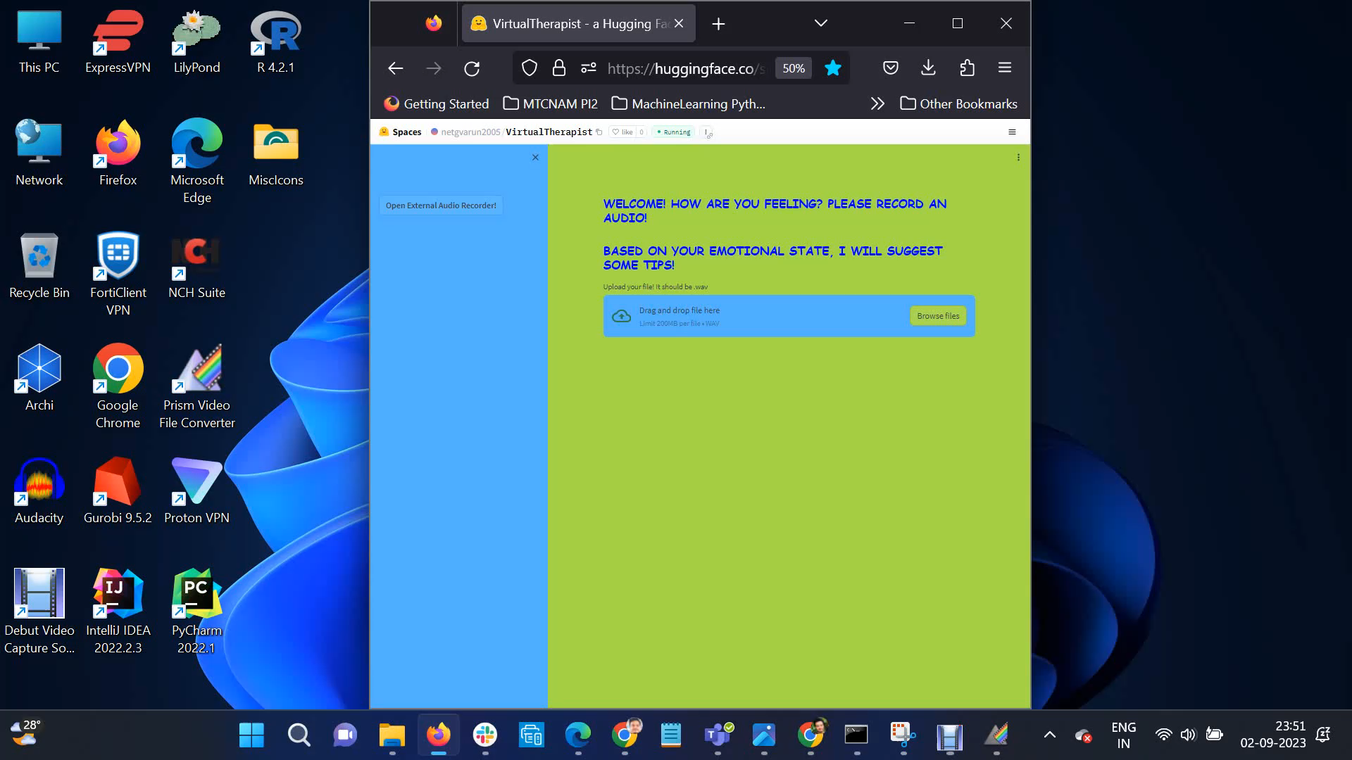
DEMO-1
Emotion Predicted : ‘Angry’
Gen-AI component generates therapeutic messages conditioned on ‘Angry’ prompt.

Slide 7

DEMO-2
Emotion Predicted : ‘Sad’
Gen-AI component generates therapeutic messages conditioned on ‘Sad’ prompt.

Slide 8
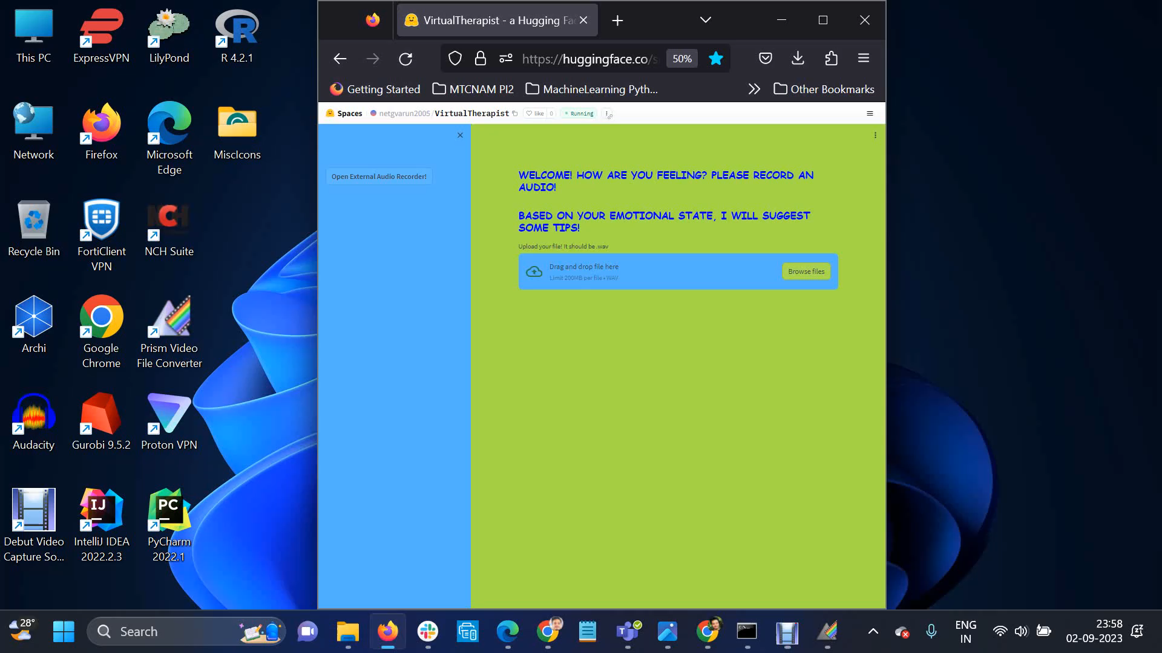
DEMO-3
Emotion Predicted : ‘Fearful’
Gen-AI component generates therapeutic messages conditioned on ‘fearful’ prompt.

Slide 9
Thank you

